Slide 1
Architecture of Microprocessors Case Study: 8085

Slide 2
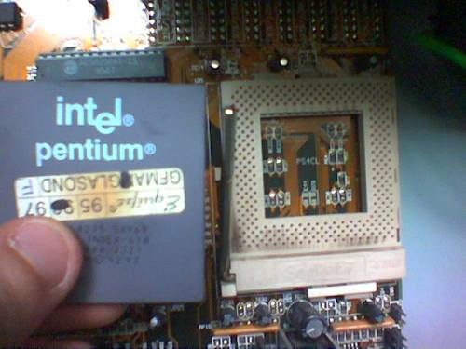
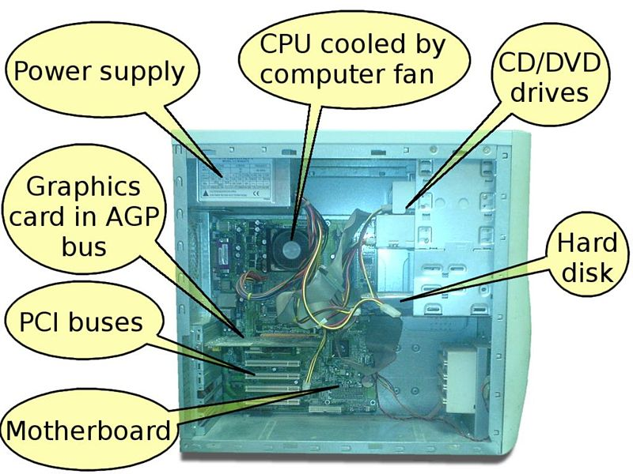

Slide 3
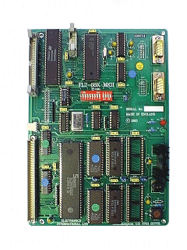
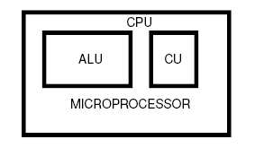
8251 (USART)
8255 (Parallel interface)
8257 (DMA
Controller)
8085/8086
8254 (Timer)
MICROPROCESSOR Based Development Board

Slide 4
What is a Microprocessor Based System?
Microcomputer is a microprocessor based system.
Includes :
Microprocessor
Input/Output
Memory
Components are connected through a communication path called a bus
How we can differentiate microcomputer and a microprocessor?
uP is one component of the microcomputer
The CPU functions of the microcomputer are performed by the uP
The term peripherals is used for I/O devices.

Slide 5
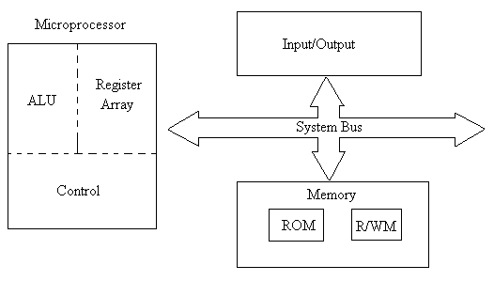
uP based System Architecture with Bus Architecture

Slide 6
What is a microprocessor?
Microprocessor :-
multipurpose,
programmable,
clock driven,
register-based electronic device
that reads binary instruction from a storage device called memory,
accepts binary data as input and
process data according to the instructions, and
provides results as output.
Manufactured by using LSI or VLSI
Microprocessor operation is similar to human brain
How we can differentiate CPU & uP ?
CPU is implemented on one or more circuit boards to perform the computing functions
uP is similar to CPU
uP - CPU on a single chip

Slide 7
Main 3 segments of uP
ALU :- This area of uP will perform various computing functions such as arithmetic operations (Addition & Subtraction) and logic operations (AND/OR/EXOR)
Register Array :- This area of uP consists of various register; B,C,D,E,H & L. Store data temporarily during execution of a program and are accessible to the user through instruction
Control Unit :- Provides necessary timing and control signals to all the operations. Controls the flow of data b/w uP and memory and peripherals.

Slide 8
Memory
Memory stores binary information as instruction and data
2 sections
Read only Memory (ROM)
Program in ROM can only be read, not altered.
Store programs that don’t need alteration
Read/Write Memory (RAM)
User Memory
Stores user program & data
Information stored can be easily read and altered
Consider the monitor program, generally stored in ROM
This program interprets the information entered through a keyboard and provides equivalent binary to the uP.
The monitor programs monitors the Hex Key and stores data in R/W memory

Slide 9
Input/ Output & System Bus
Input/Output :-
Also known as peripherals
Communicating with the outside world through I/O
Inputs devices :- keyboard, switches, ADC
Transfer binary information from outside world to the uP
Output devices:- LED, CRT, Video screen (monitor), XY Plotter, Magnetic Tape, DAC
Transfer data from uP to the outside world
System Bus:-
Communication path between the uP and peripherals
Bus - Group of wires to carry bits
All peripherals share the same bus
uP communicates with only one peripheral at a time
Timing is provided by the CU of the uP.

Slide 10
How does a uP works?
Fetch, Decode, Execute
uP fetches the first instruction from the memory
Decodes it
Execute the instruction
Uses the system bus to fetch the instruction and data from the memory in the entire process
Uses registers to store data temporarily
Performs the computing function in the ALU
Sends out the result in binary using the same bus lines to the o/p.

Slide 11
Terminology
Word :- No: of bits uP recognizes and process at a time
Machine Language:-
uP communicates and operates in 0’s & 1’s
For communication, give the instruction in binary language
Assembly language
Programmer writes the program in words
Symbolic code for each instruction, called mnemonics
Assembler :-
Program that translates the mnemonics entered from the keyboard into the corresponding binary machine codes of the uP

Slide 12
INTEL 8085-Features
It is an 8 bit general purpose microprocessor.
It is a single chip N-MOS device with 40 pins.
Capable for addressing 64K of memory
It has multiplexed address and data bus.(AD0-AD7).
It works on 5 Volt dc power supply.
The maximum clock frequency is 3 MHz - (8085A-5MHz)
It provides 74 instructions with 5 different addressing modes.

Slide 13
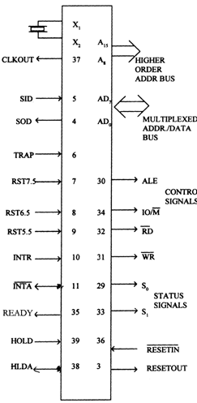
Signals can be classified into 6 groups:
Address Bus
Data Bus
Control and Status signals
Power supply and frequency signals
Externally initiated signals
Serial I/O ports

Slide 14
Multiplexed Address/Data Bus
AD7-AD0 are bidirectional
Low order address bus or data bus
Earlier part of cycle, acts as low order address bus
Later part, acts as data bus
Address Bus
16 address lines
A15 – A8 & AD7 – AD0
A15 – A8 are unidirectional, called high order address
AD7 – AD0 for dual purpose
Control & Status Signal
2 control signals (RD & WR)
3 Status signals (IO/M, S1 & S0)
1 Special Signal (ALE)
Externally Initiated Signals
Includes 5 Interrupt signals
INTR, INTA, RST 7.5, RST 6.5, RST 5.5, TRAP
3 DMA (Direct memory Access) Controller signals
HOLD, HLDA, READY
RESET IN
RESET OUT
Power Supply and Clock Frequency
Vcc - +5V power supply
Vss – Ground Reference
X1and X2 are the inputs from the crystal or clock generating circuit.
The frequency is internally divided by 2.
So, to run the microprocessor at 3 MHz, a clock running at 6 MHz should be connected to the X1 and X2 pins. (Crystal of 6MHz frequency should be connected)
CLK OUT – Clock Output
An output clock pin to drive the clock of the rest of the system.
Serial I/O Ports
SID – Serial Input Transmission
SOD – Serial Output Transmission

Slide 15
8085 Models
Hardware Model (physical electronics components)
Programming Model (information needed to write program)

Slide 16
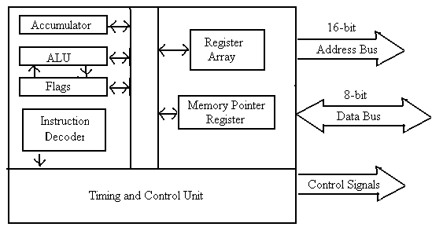
8085 Hardware Model
2 major segments
Segment 1
ALU
8-bit Accumulator
Instruction Decoder
Flags
Segment 2
8-bit & 16 bit Register

Slide 17
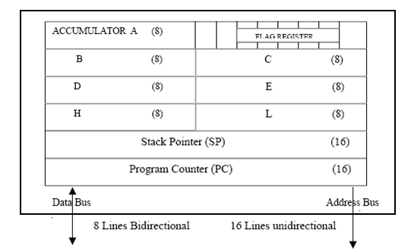
8085 Programming Model
Includes some segments of ALU and registers
Includes information critical for writing assembly language
6 GPR
1 Accumulator
1 Flag register
16-bit Program Counter
16-bit Stack Pointer

Slide 18
Program Counter
16–bit register hold memory address
PC is used to sequence the execution of the instruction
Function of PC is to point to the memory address from which the next byte is to be fetched
When a byte (machine code) is being fetched, the program counter is incremented by one to point to the next memory location
Stack Pointer
16-bit register used as a memory pointer
It points to a memory location in R/W memory, called the stack
The beginning of the stack is defined by loading 16-bit address in the stack pointer.
The stack is the sequence of memory locations defined by the programmer.
The stack is used to save the content of a register during the execution of the program.

Slide 19
8085 Architecture
ALU
Timing & Control Unit
Instruction Register and Decoder
Register Array
Interrupt Control
Serial I/O Control

Slide 20

Aum Amriteswaryai Namah:
8085 ARCHITECTURE
SID
SOD
Power Supply +5v
INTR
INTA
RST5.5
RST6.5
RST7.5
TRAP
Ground
Interrupt Control
Serial I/O Control
8 bit Internal Data Bus
Accumulator
(8)
Temp.Reg
(8)
Instruction
Reg.(8)
Multiplexer
W (8)
Temp.Reg.
Z (8)
Temp.Reg.
Flag
Flip-Flops(5)
Instruction Decoder and Machine Cycle Encoder
B Reg.(8)
C Reg.(8)
Reg.Select
D Reg.(8)
E Reg.(8)
H Reg.(8)
L Reg.(8)
A L
U
Stack Pointer(16)
(8)
Program Counter(16)
Incrementer/Decrementer Address Latch (16)
Timing and Control
CLK
GEN Control Status DMA Reset
X1
Address
Buffer (8)
Data/Address Buffer(8)
X2
CLK OUT
Ready
ALE
S0
S1
IO/M
HOLD
HLDA
Reset OUT
A₁₅ - A₈
(Address Bus)
AD₇ – AD₀
(Address/Data Bus)
RD
WR
Reset IN

Slide 21
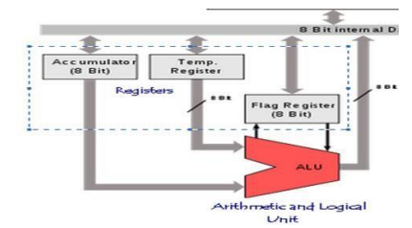
ALU (ARITHMETIC AND LOGICAL UNIT)
It is referred to be as ALU which acts as a backbone for any arithmetic and logical operation as addition, subtraction, division, multiplication, AND, OR, NOT etc.
Once the operation is performed, the result will be stored in accumulator, which is again a register.

Slide 22
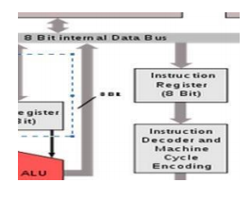
Timing and Control Unit
Synchronizes all the uP operation with the clock
Generates control signal necessary for the communication between uP and peripherals
Instruction Register and Decoder
Instruction register is a temporary storage area for the current instruction before it is being executed.
Instruction fetched from memory is loaded into IR
Decoder decodes the instruction & establishes the sequence of events to follow
Not programmable & cannot accessed through any instruction
Decoded instruction will be then moved to the next stage

Slide 23
ACCUMULATOR
Most important component of the entire Mu-P. 8 bit register.
It is inevitable in all the arithmetic and logical operations since the result is going to be stored in this register.
It is represented by the character A.
When there is a new 8 bit data entering, the previously stored data will get automatically over written.
Any operation that is happening will happen through Accumulator register only.
Without Accumulator, Nothing would happen

Slide 24
Flag Register
S | Z | X | AC | X | P | X | CY

Slide 25
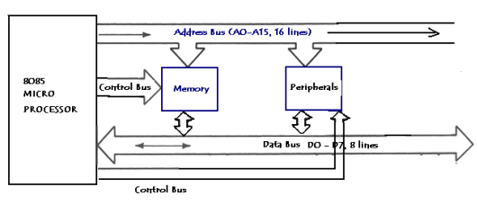
BUS STRUCTURE IN 8085
What a bus is?
A bus is as simple as the bus that people travel with. What is it meant for?
It takes people and freight from a place to another.
Same is the case here with microprocessor.
Microprocessor often needs to send lot of control signals, data etc. to the peripherals and devices connected to it.
All those are carried via the bus. In short it is the medium.

Slide 26
Address Bus
Address bus
As the name indicates it is used to carry the address.
8085 has 16 address lines which means it can have 2^16 = 65536bytes memory locations.
The address bus will be mainly used to recognize a memory location or a connected peripheral.
Postman basically delivers the letters using address. Likewise it is mandatory to have the identity for the memory locations and it is referred to be as an address.
Address bus is always unidirectional. The communication happens from microprocessor to the peripherals

Slide 27
Data Bus
Data bus
This is bidirectional wires which carries data from to Microprocessor.
Any information that gets in or goes out of Microprocessor is through the data bus only.
There are 8 data lines from D0 to D7 as and this is the reason why we call it an 8 bit processor.
Data bus is used to carry the instructions, results of the operations etc. to the peripherals and memory unit.
When we quote that it is an 8 bit processor, it implies that the large data chunk has to be broken into smaller ones of up to 255 (o to 255, 28 )

Slide 28
Control Bus
Control bus
All the controlling actions are carried out through these lines.
It can be unidirectional or bidirectional.
The control signals will intimate the microprocessor on where to read or where to write.
Many control signals are available with 8085.
All of them are discussed in detail when the pin description of 8085 is handled. Reader has to wait till then.

Slide 29
Processor Cycles
Instruction Cycle:
The sequence of operations that a processor has to carry out while executing the instruction is called instruction cycle.
Machine Cycle:
Each instruction cycle of a processor consist of a number of basic operations called machine cycles or processor cycles.
Instruction Cycle
Fetch Cycle
Execute Cycle

Slide 30
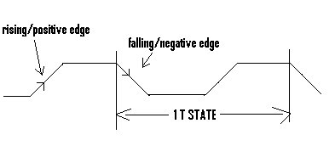
T States
The time taken by the processor to execute a machine cycle is expressed in T - States.
One T – state is equal to the time period of the internal clock signal of the processor.
The T- state starts at the falling edge of a clock.

Slide 31
Thank You

Slide 32

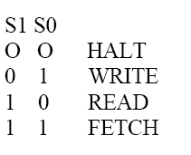
Aum Amriteswaryai Namah:
PIN DIAGRAM
X1
1
8085
40
Vcc
X2
2
39
HOLD
RESET OUT
HLDA
3
38
SOD
CLK(OUT)
4
37
SID
RESET IN
5
36
TRAP
6
35
READY
RST 7.5
7
34
IO/M
RST 6.5
S1
8
33
RST 5.5
RD
9
32
INTR
WR
10
31
INTA
ALE
11
30
AD0
S0
12
29
AD1
A15
13
28
AD2
A14
14
27
AD3
A13
15
26
AD4
A12
16
25
AD5
A11
17
24
AD6
A10
18
23
AD7
A9
19
22
Vss
A8
20
21

